Slide 1
Umbraco 9
What a Performance!
By Paul Seal and Matt Hart from Moriyama

Slide 2



Who are we?
Umbraco 9 – What a Performance!
Paul Seal
Matt Hart
Moriyama
Umbraco Certified Master
4 x Umbraco MVP
YouTuber 😃
Umbraco Certified Master
Azure Advocate
DevOps Enthusiast 🚀
Umbraco Gold Partner
Contributing Gold Partner
Umbraco and Azure Specialists ⭐

Slide 3
About this talk
Umbraco 9 – What a Performance!
1
2
3
Measure
Compare
Value
We wanted to measure the speed of Umbraco 9 ourselves to see how much faster it really is.
We wanted to compare v8 with v9 but also which v9 platform is the best, Windows or Linux.
Work out which are the best value for money price plans on Azure

Slide 4
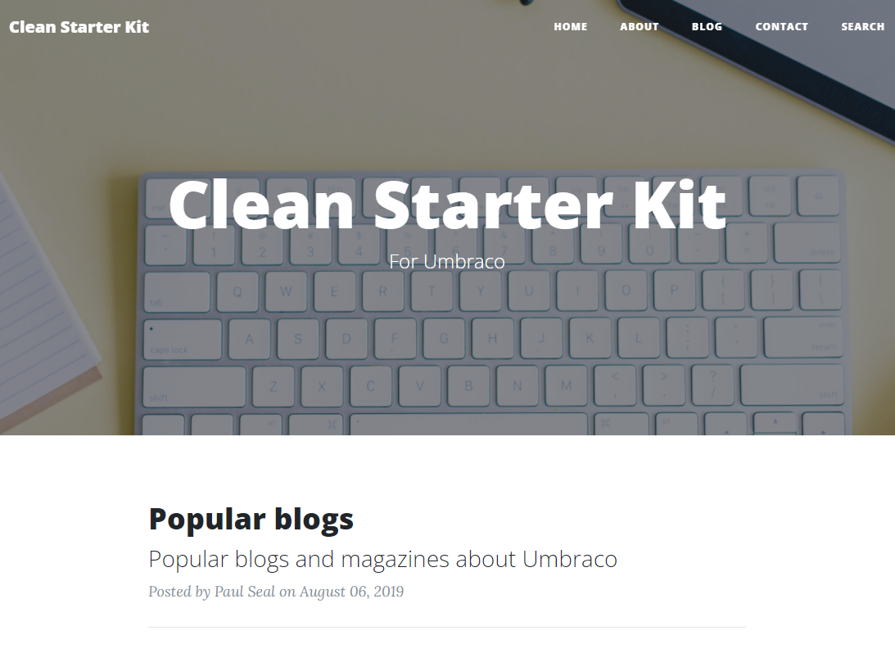
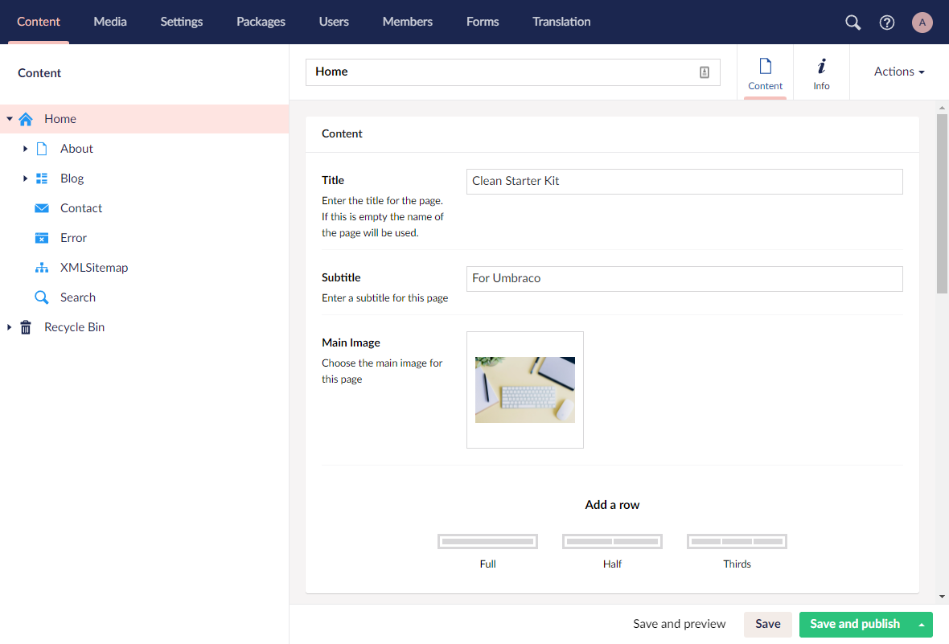
Installed Clean Starter Kit
Umbraco 9 – What a Performance!

Slide 5
Level Playing Field
Umbraco 9 – What a Performance!
v8
v9
v9
.NET Framework
Windows .NET 5 (Core)
Linux .NET 5 (Core)
Clean Starter Kit installed, with 200 extra pages
Clean Starter Kit installed, with 200 extra pages
Clean Starter Kit installed, with 200 extra pages

Slide 6
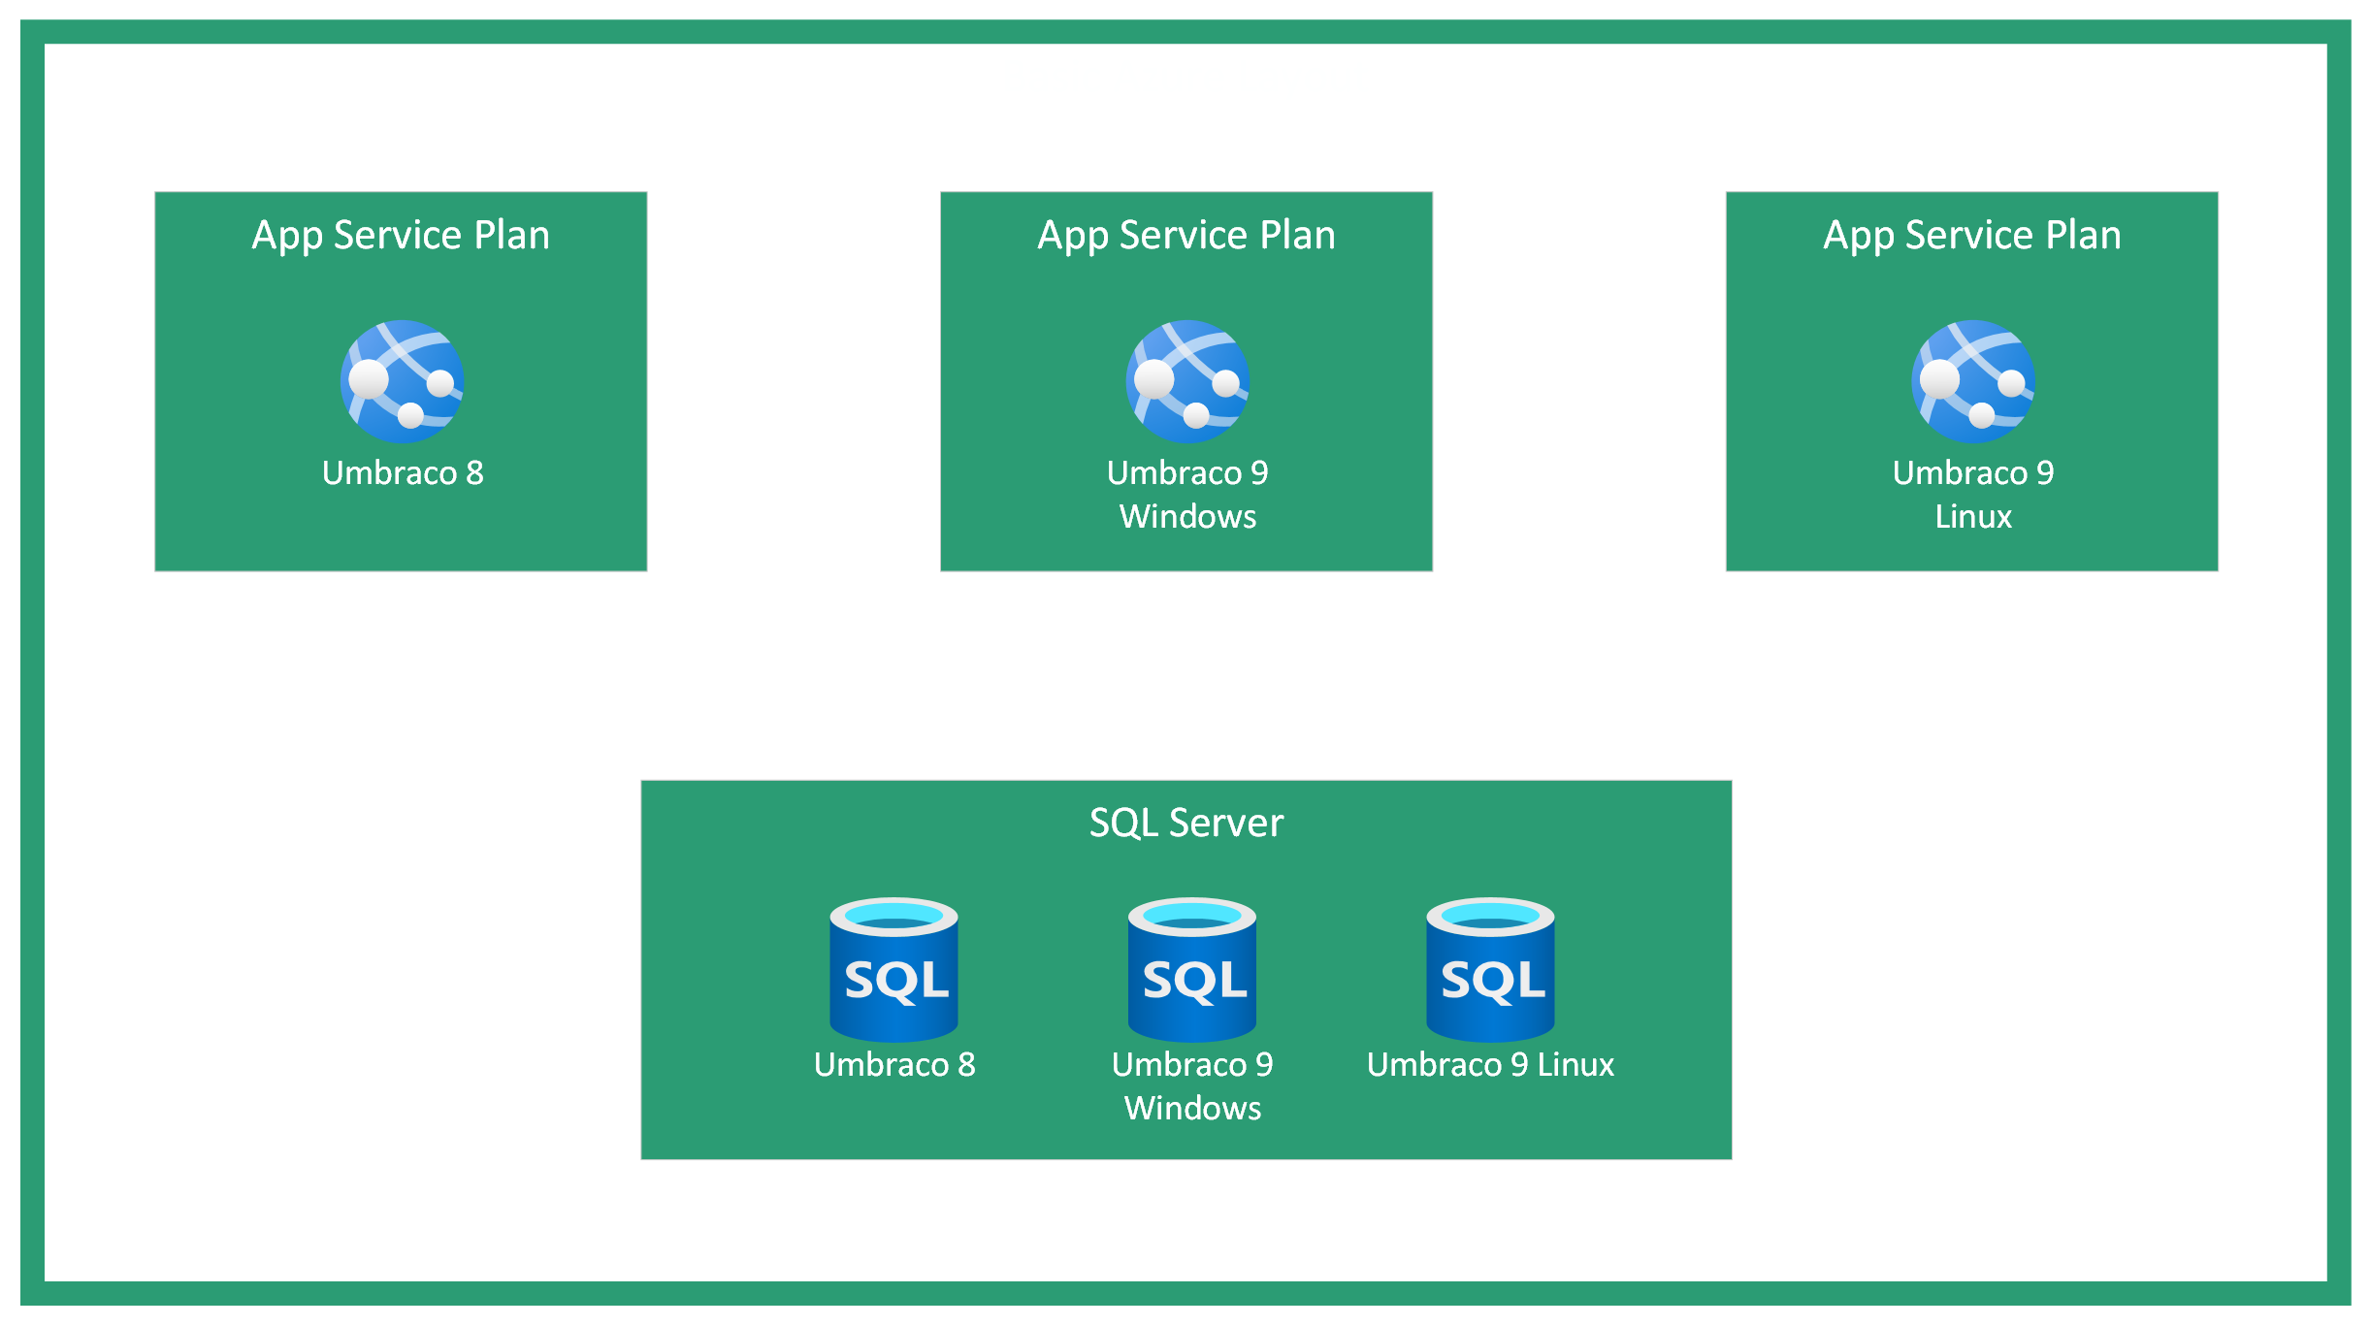
Deployed to Azure
Umbraco 9 – What a Performance!

Slide 7
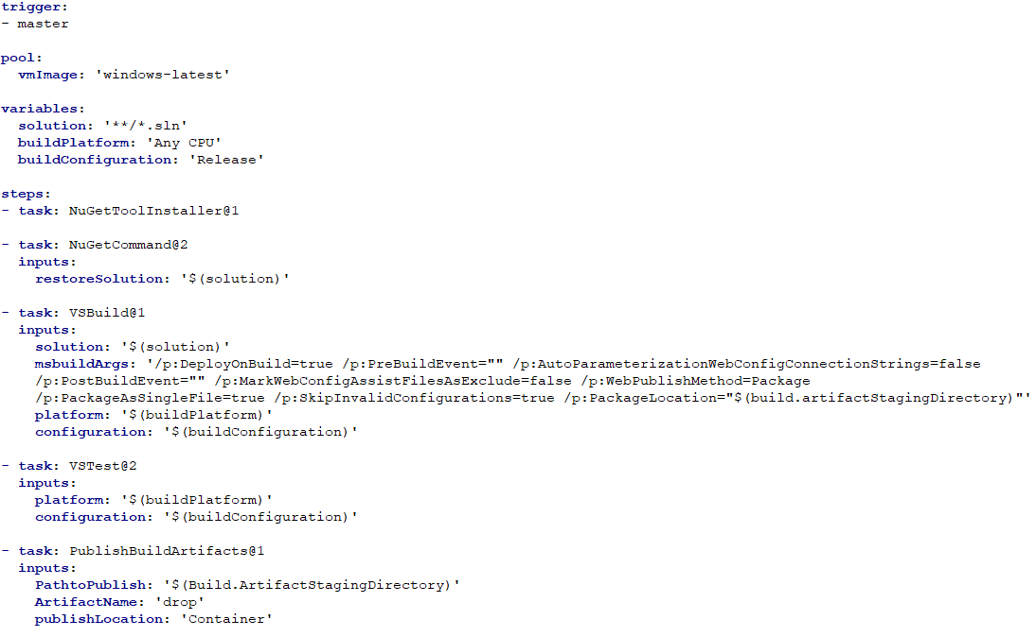
Azure Pipeline Windows v8
Umbraco 9 – What a Performance!

Slide 8
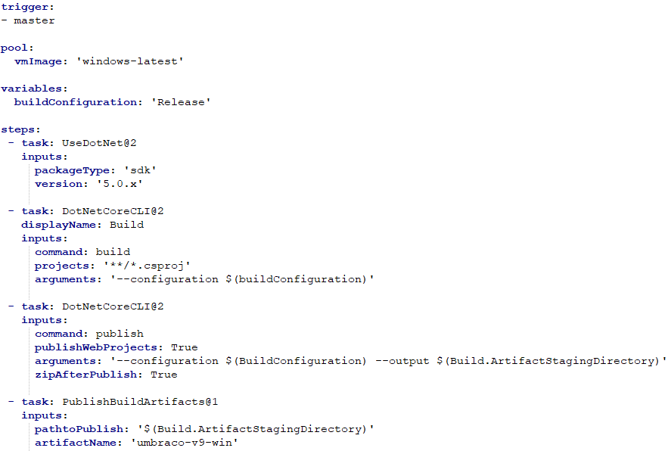
Azure Pipeline Windows v9
Umbraco 9 – What a Performance!

Slide 9
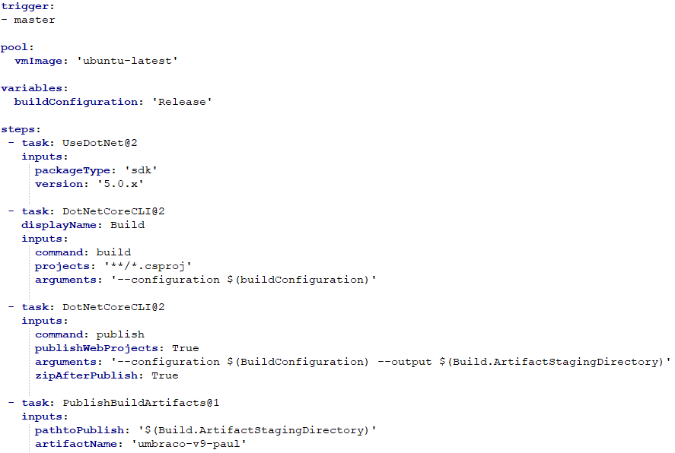
Azure Pipeline Linux v9
Umbraco 9 – What a Performance!

Slide 10
k6
Umbraco 9 – What a Performance!

Slide 11
k6 Sample Requests
Umbraco 9 – What a Performance!
export default function main() {
let response;
var appServiceName = "clean-umbraco-v8-framework-app";
group(
"main pages - https://" + appServiceName + ".azurewebsites.net/",
function () {
var pages = ["/", "/about/", "/blog/", "/contact/", "/search/", "/blog/popular-blogs/", "/blog/conferences/", "/blog/meetups/", "/blog/community/"]
var pageCount = pages.length;
for (var i = 0; i < pageCount; i++) {
response = http.get(
"https://" + appServiceName + ".azurewebsites.net" + pages[i],
{
headers: {
"upgrade-insecure-requests": "1",
"sec-ch-ua":
'"Google Chrome";v="95", "Chromium";v="95", ";Not A Brand";v="99"',
"sec-ch-ua-mobile": "?0",
"sec-ch-ua-platform": '"Windows"',
},
}
);
sleep(1);
}
}
);
}

Slide 12
k6 Ramping up VUs
Umbraco 9 – What a Performance!
scenarios: {
login: {
executor: 'ramping-vus',
startVUs: 0,
stages: [
{ duration: '5m', target: 100 },
{ duration: '10m', target: 200 },
{ duration: '15m', target: 500 },
{ duration: '15m', target: 1000 },
{ duration: '15m', target: 0 }
],
gracefulRampDown: '0s',
},
}

Slide 13
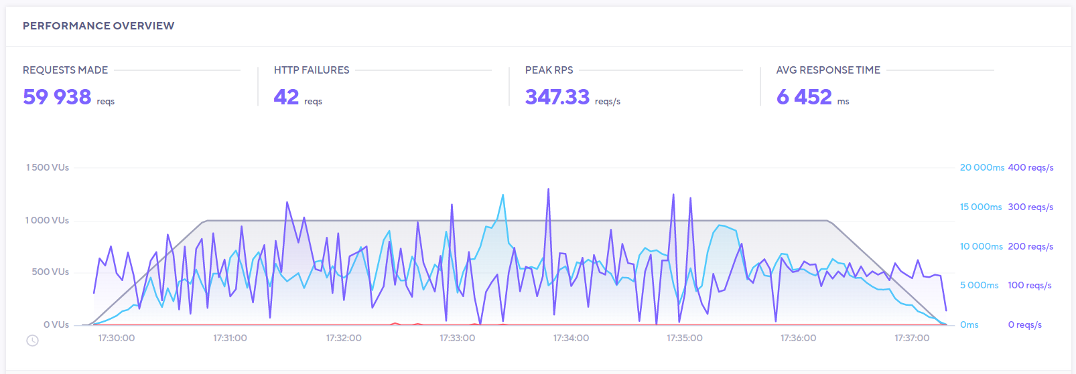
We made some Mistakes
Umbraco 9 – What a Performance!
Umbraco 9 – What a Performance!

Slide 14
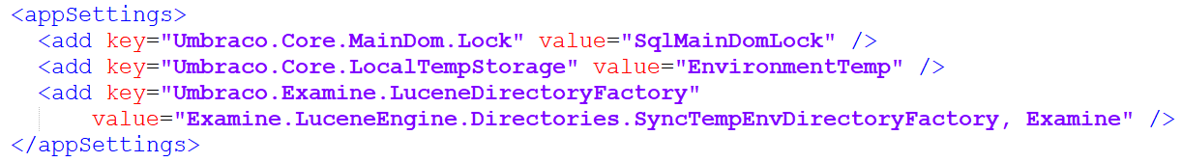
Azure App Settings Windows v8
Umbraco 9 – What a Performance!
Umbraco 9 – What a Performance!

Slide 15
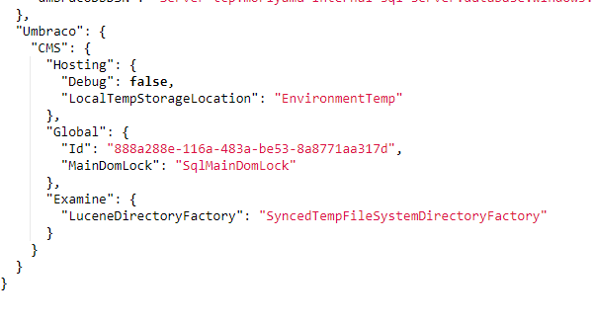
Azure App Settings v9 Windows and Linux
Umbraco 9 – What a Performance!
Umbraco 9 – What a Performance!

Slide 16

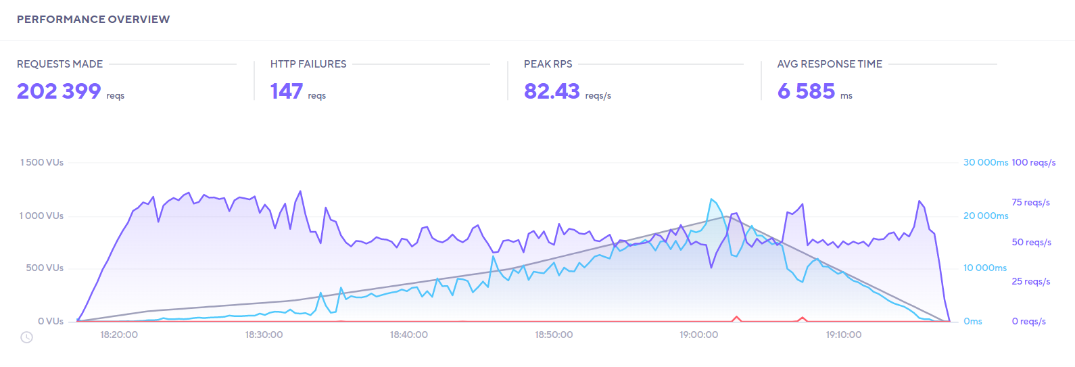
B1 Windows v8
Umbraco 9 – What a Performance!

Slide 17
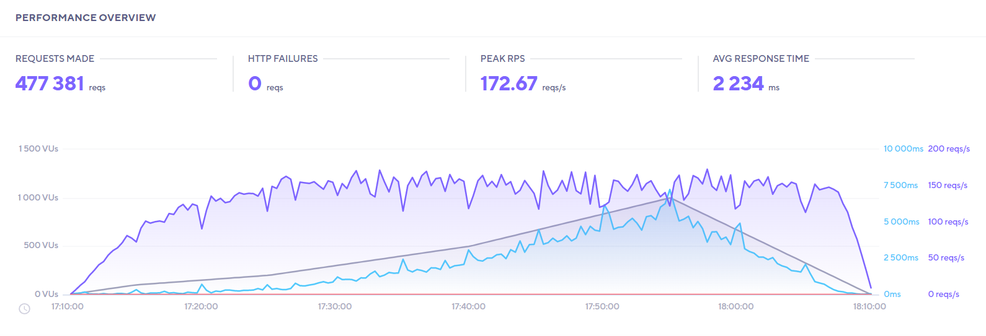
B1 Linux v9
Umbraco 9 – What a Performance!

Slide 18
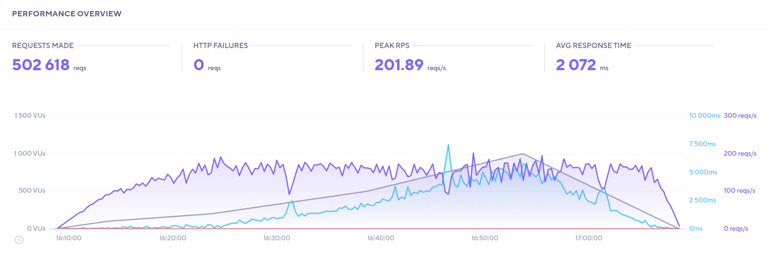
B1 Windows v9
Umbraco 9 – What a Performance!

Slide 19
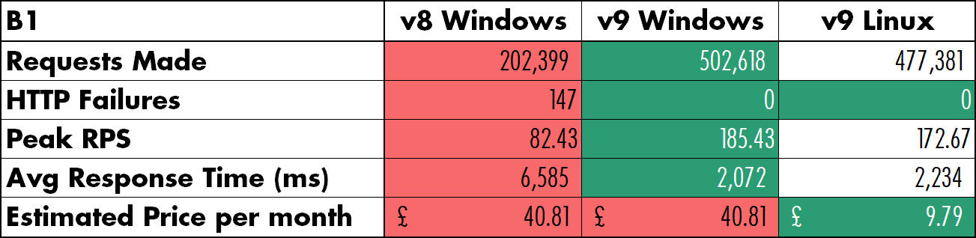
B1 Test Results
Umbraco 9 – What a Performance!

Slide 20
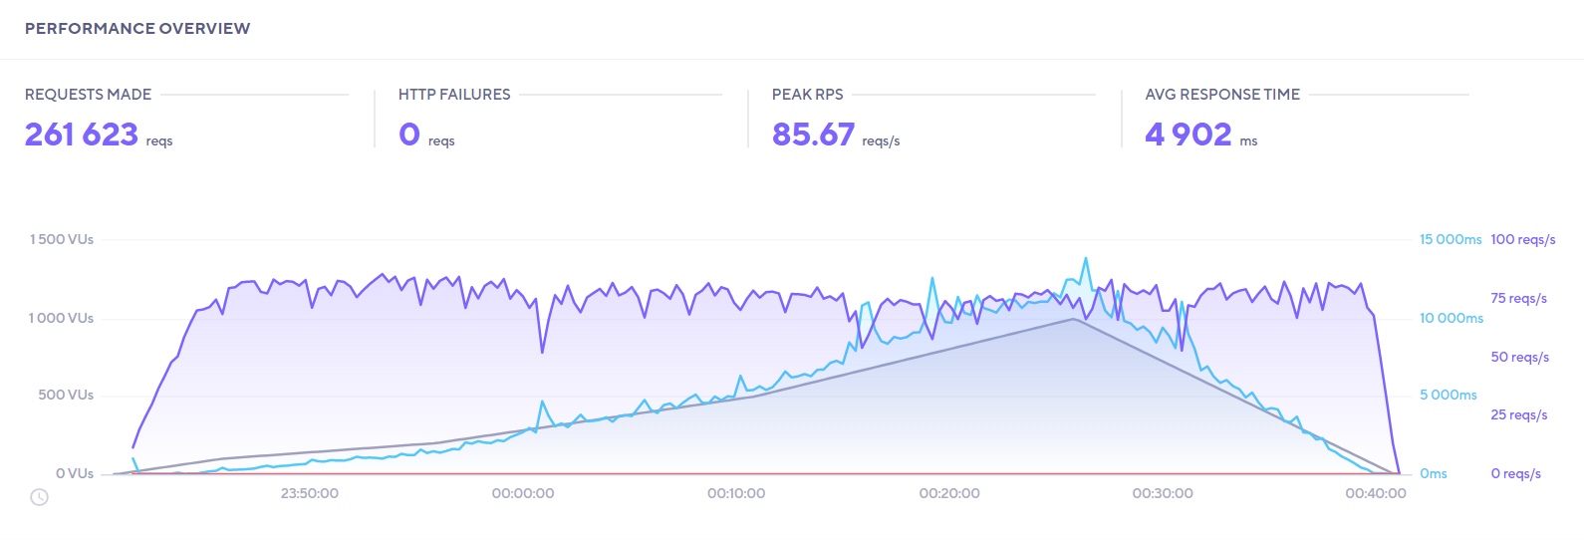
S1 Windows v8
Umbraco 9 – What a Performance!

Slide 21
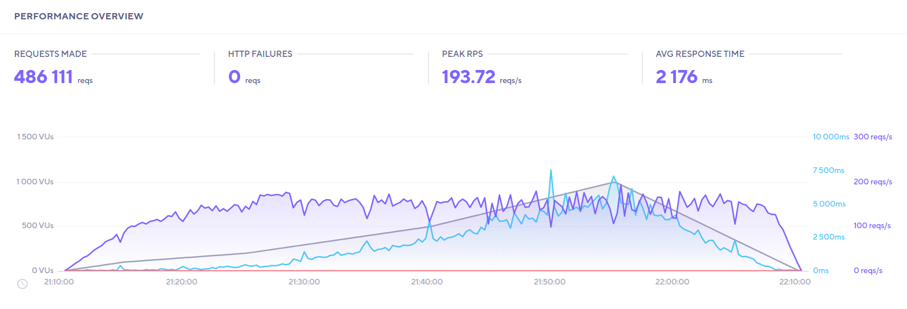
S1 Linux v9
Umbraco 9 – What a Performance!

Slide 22
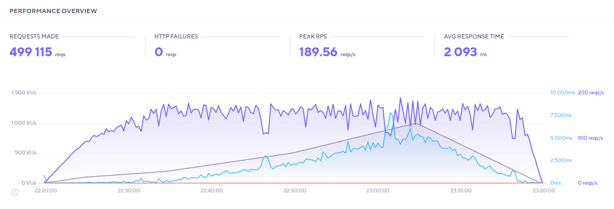
S1 Windows v9
Umbraco 9 – What a Performance!

Slide 23
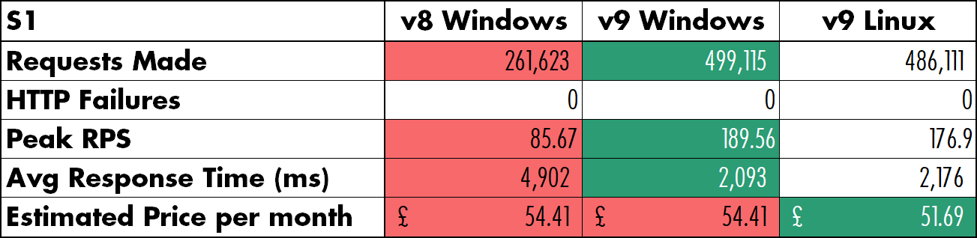
S1 Test Results
Umbraco 9 – What a Performance!

Slide 24
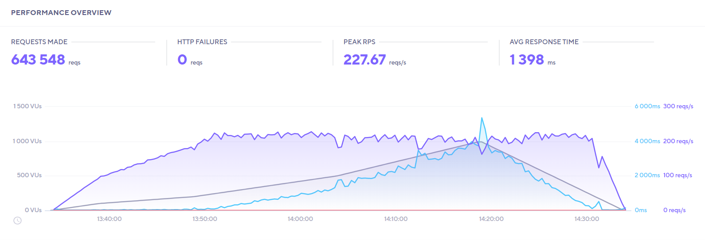
P1V2 Windows v8
Umbraco 9 – What a Performance!

Slide 25
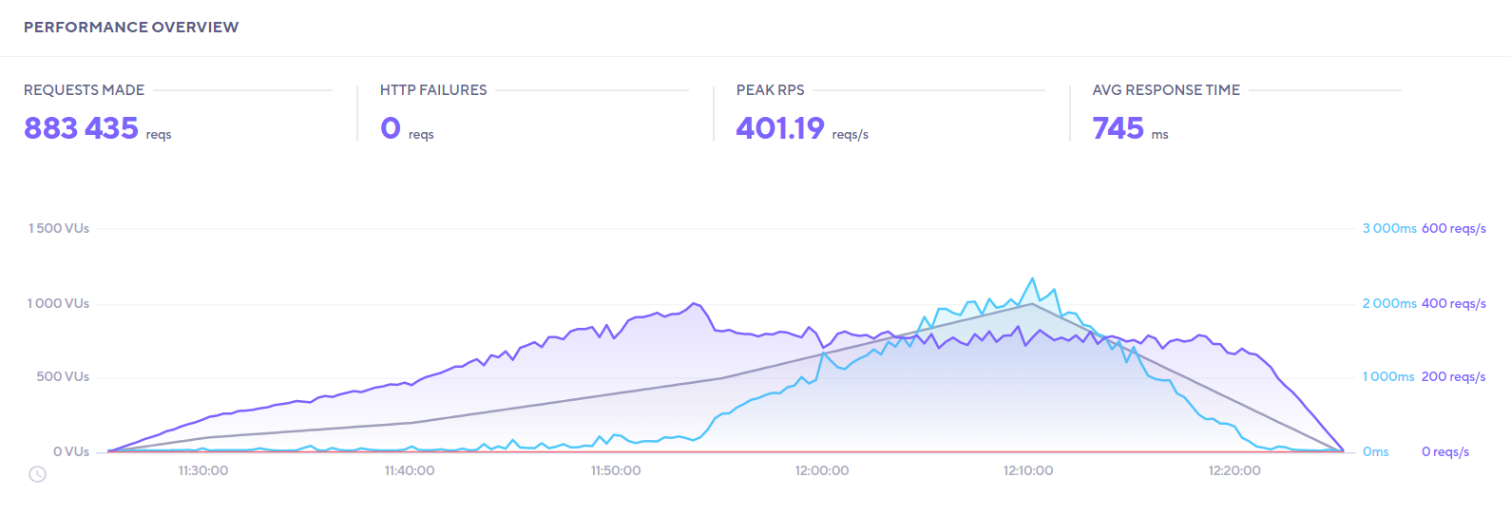
P1V2 Linux v9
Umbraco 9 – What a Performance!

Slide 26
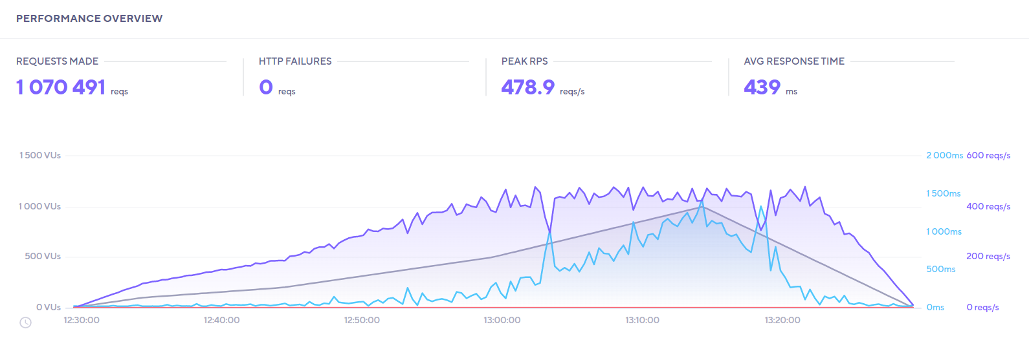
P1V2 Windows v9
Umbraco 9 – What a Performance!

Slide 27
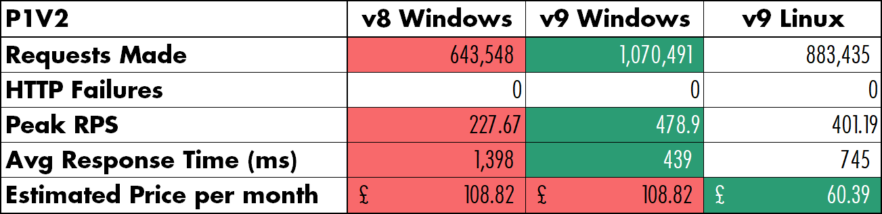
P1V2 Test Results
Umbraco 9 – What a Performance!

Slide 28
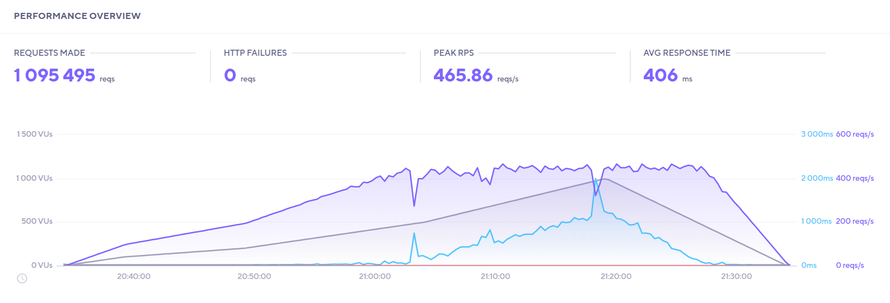
P2V2 Windows v8
Umbraco 9 – What a Performance!

Slide 29
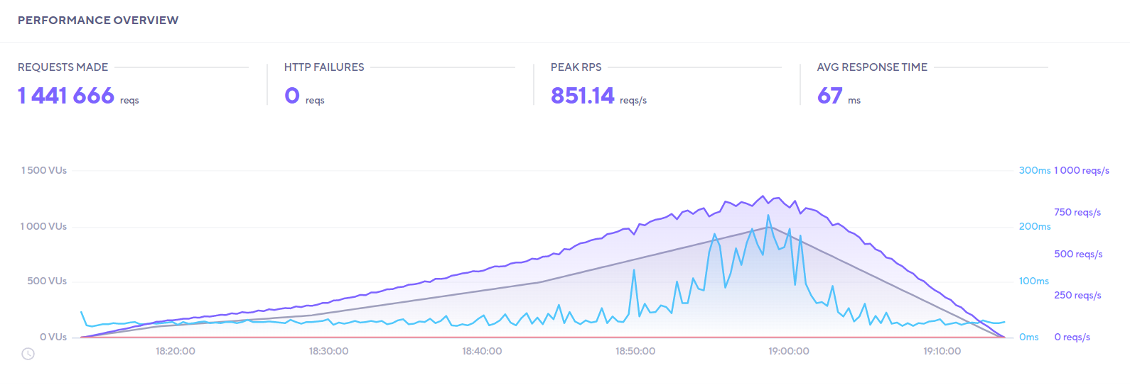
P2V2 Linux v9
Umbraco 9 – What a Performance!

Slide 30

P2V2 Windows v9
Umbraco 9 – What a Performance!

Slide 31

P2V2 Test Results
Umbraco 9 – What a Performance!

Slide 32
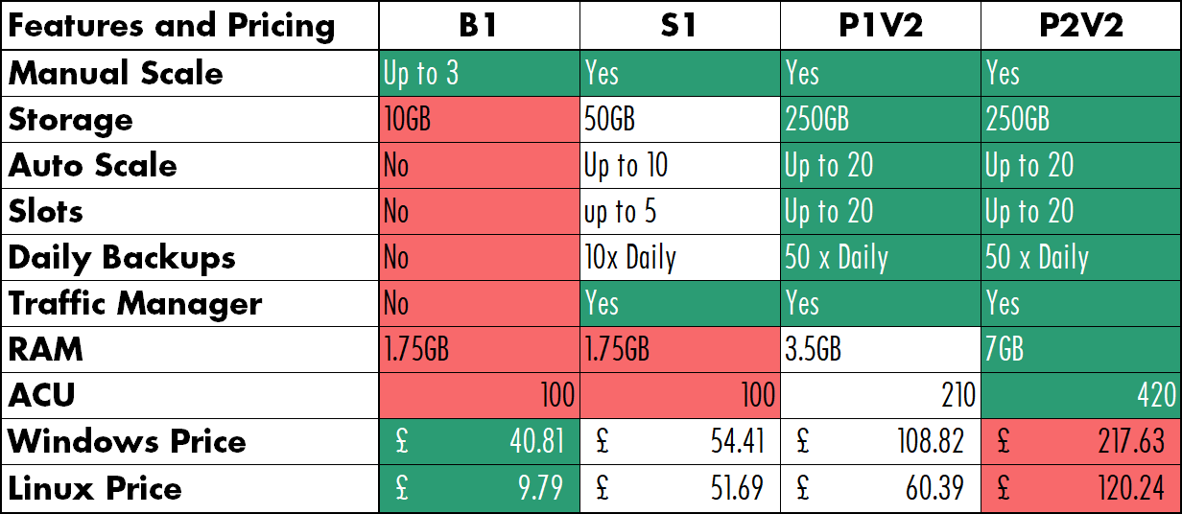
Features and Pricing Comparison
Umbraco 9 – What a Performance!

Slide 33
Backoffice Testing
Umbraco 9 – What a Performance!

Slide 34
Summary
Umbraco 9 – What a Performance!
V9 is much faster than v8
If you want pure speed, go for v9 on Windows
If you want value for money, go for v9 on Linux

Slide 35
Contact details
Umbraco 9 – What a Performance!
Paul Seal
Matt Hart
Moriyama
@CodeSharePaul
codeshare.co.uk
codeshare.co.uk/youtube
@mattou07
mu7.dev
@moriyamaumbraco
moriyama.co.uk

Slide 36
Thank you!

